Slide 1
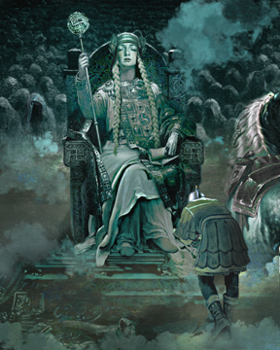
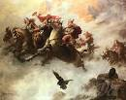
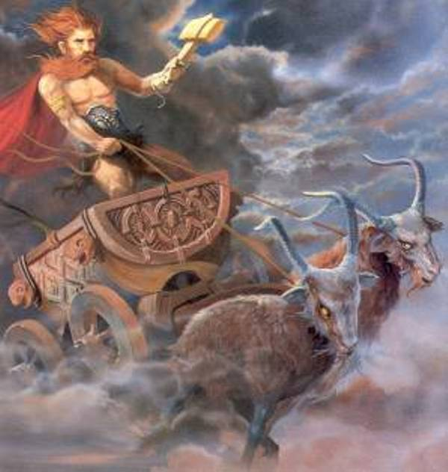
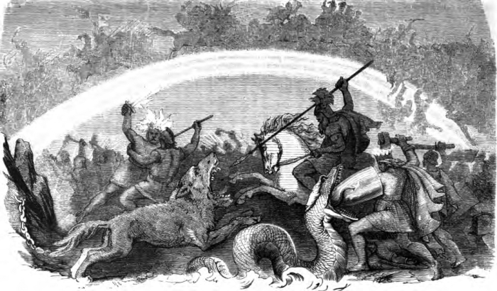
Archetypes Of Norse
Nyasia Lindsey, Miasia Taylor, Savanna

Slide 2
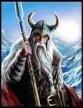
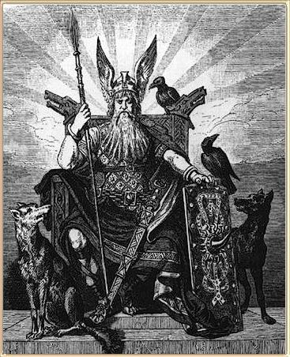
Odin: King Of Aesir
Out of all of Norse gods, Odin was one of the most tragic and noble. He possessed a wisdom so vast and all-encompassing that he was unable to be of good cheer, since he was unable to see forward into the future to the time of Ragnoarok, when the gods and the universe would be destroyed.
Sometimes known as Wotah or Woden
The day Wednesday was named after him
Typically characterized as the sprit of the universe itself, the god of wisdom that comes with age, and the protector of warriors whose hearts are true courageous.

Slide 3
The Viking: People of the Inlets
Scandinavian warriors who raided the cost of inlets of Europe and British isles from the 9th to 12th century(the Viking age).
Their greatest achievements were in ship building and navigation.
They ventured as far as Greenland, Iceland and North America.
The typical long ship was graceful vessel with a high prow adorned with the figure of an animal, often a dragon and a high curve stern.
Had a square sail and was powered by oarsmen who hung their shields over the side of the ship.

Slide 4
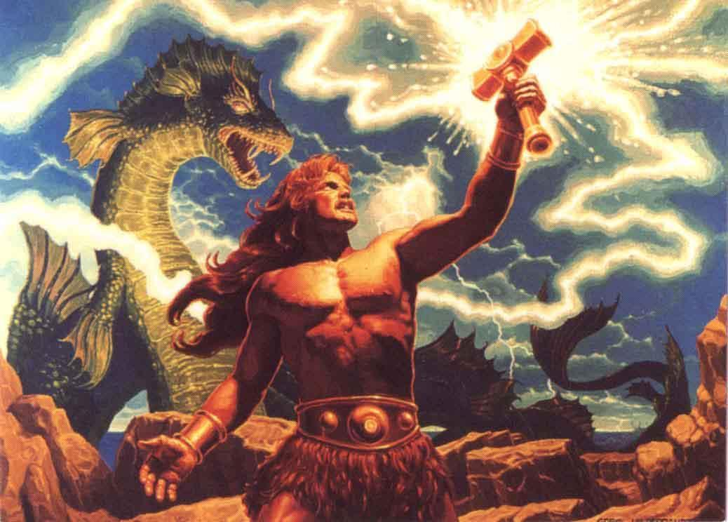
Thor: The God Of Thunder
The mighty Thor, who is known primarily at the thunder of god was also the Norse god of war and agriculture.
He was among the great gods of Aesir, second to his father, Odin. His mother was Fiorgyn, (the beautiful giantess).
His hammer (also created by the dwarfs) were as destructive as the thunderbolts of Zeus.
Thursday was originally named after Thor and more widely worshipped than any other god by the ancient Norsemen.

Slide 5
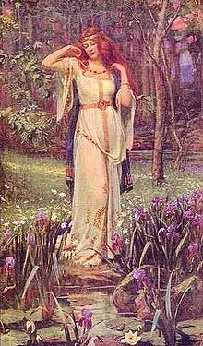
Frigg: Queen Of Asgard
Frigg was known as the protectress of marriage and goddess of the hearth.
Frigg was the wife of Odin and the step mother to Thor, Tyr, Hermodr, Hodur, and Bragi.
She was a prophetess who spun the clouds. Her name means beloved lady and the weekday Friday is named after her.

Slide 6
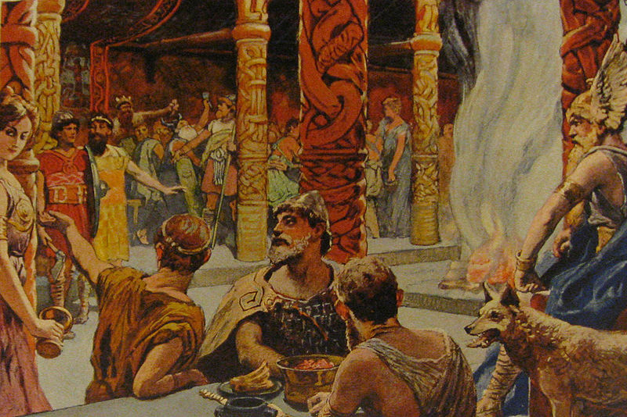
The Hall Of Dead Heroes
Valhia, the hall of dead heroes was built by Odin, the all father warrior of god Aesir. Valhia was situated in Godsheim, Odin's Realm in Asgard. The roof wasted with shining shields; the

